Slide 1
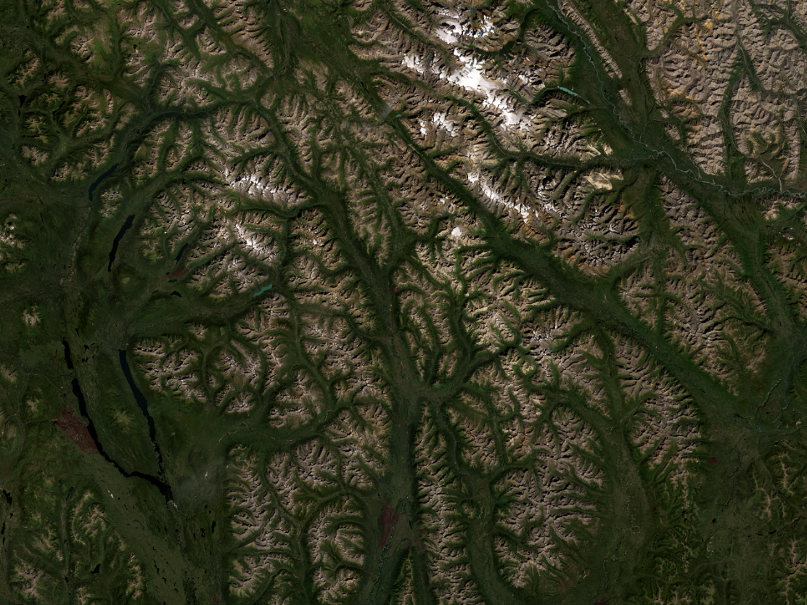


BEACONs Project
Boreal Ecosystems Analysis for Conservation Networks
www.beaconsproject.ca
Applications of disturbance mapping to
conservation planning
Pierre Vernier, Marc Edwards, Melina Houle, Kim Lisgo and Fiona Schmiegelow
BCPARF
December 13, 2022

Slide 2
Using regional disturbance maps in conservation applications:
Explore regional disturbances
Create and export custom footprint and intactness maps
Evaluate assumptions about buffer sizes and minimum patch sizes

Slide 3
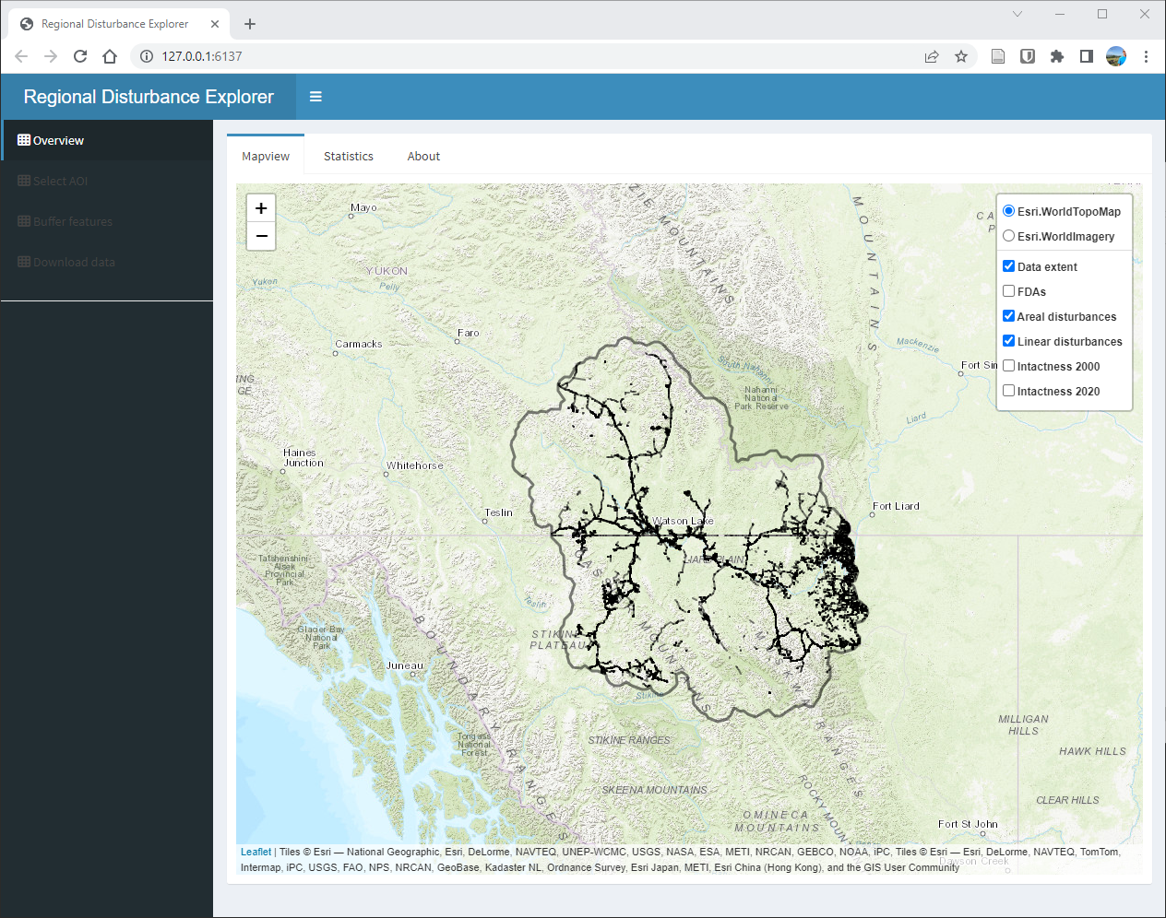
Disturbance Explorer – Overview

Slide 4
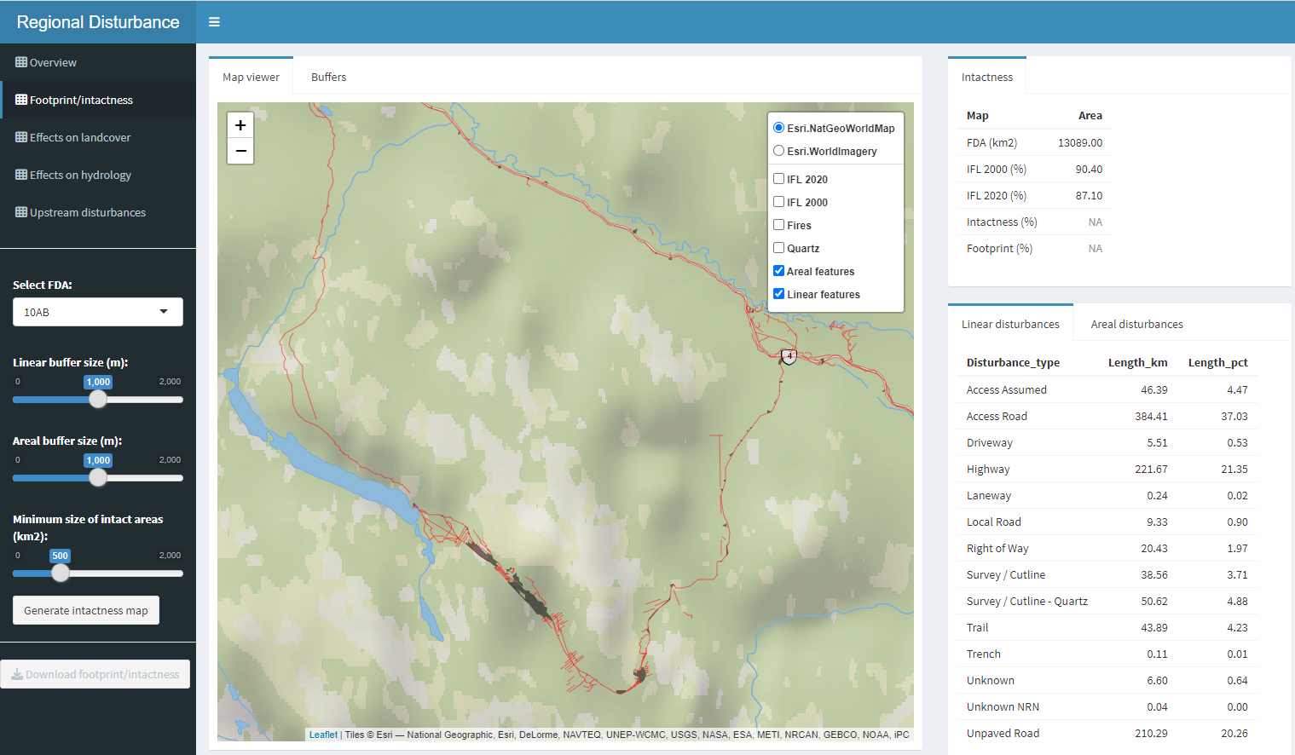
Application 1: App to explore regional disturbances

Slide 5
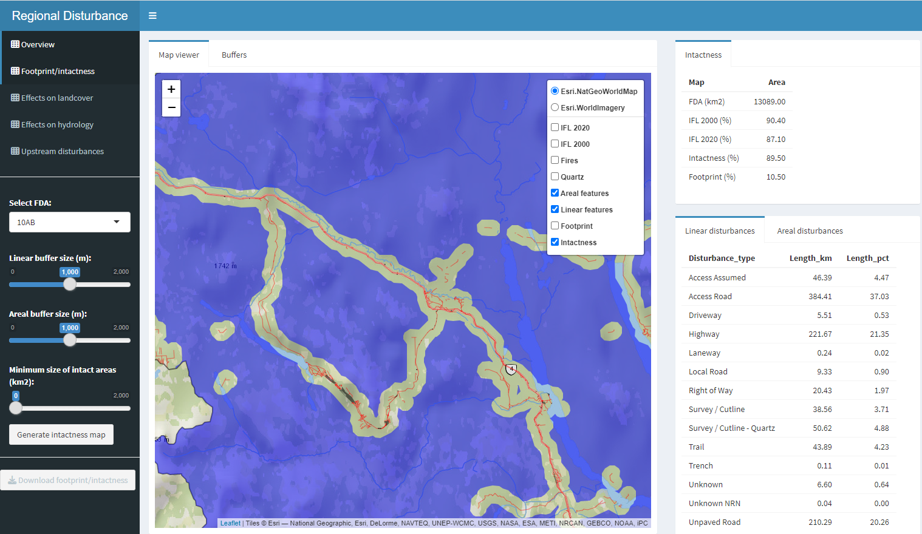
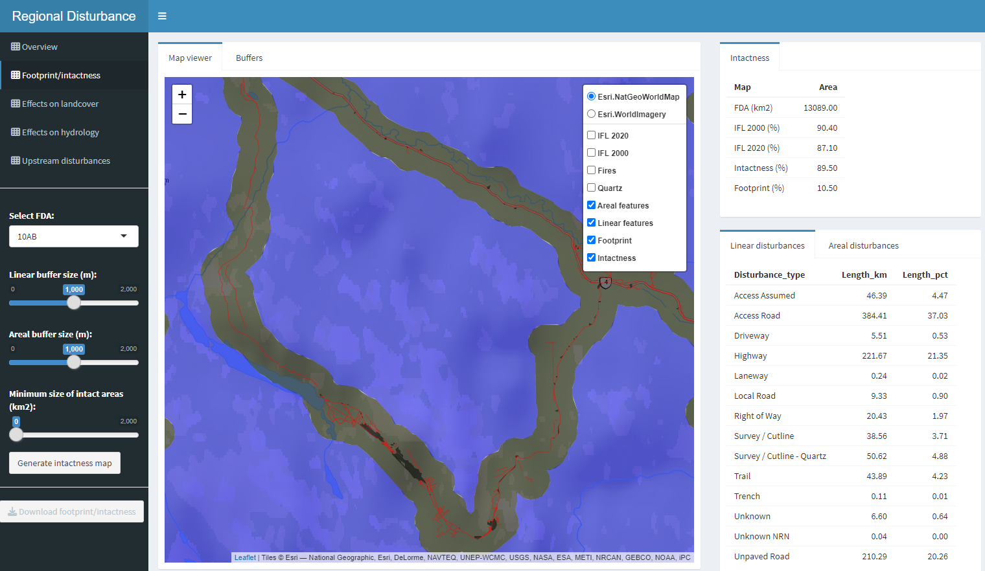
Creating footprint and intactness maps

Slide 6
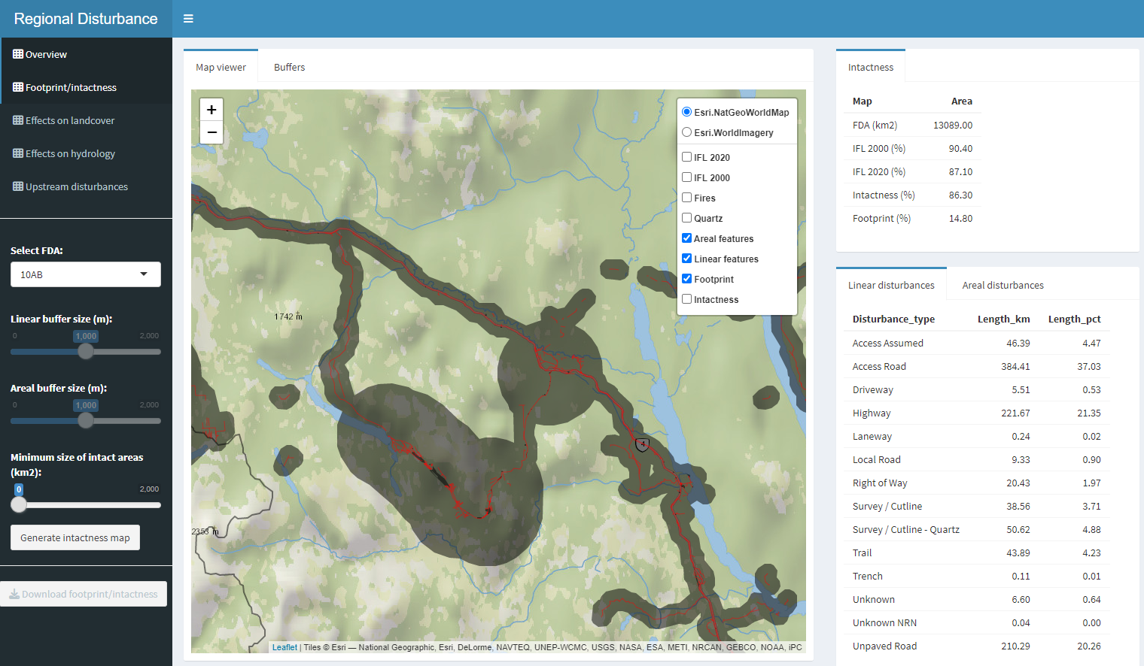
Customizing buffers

